Slide 1
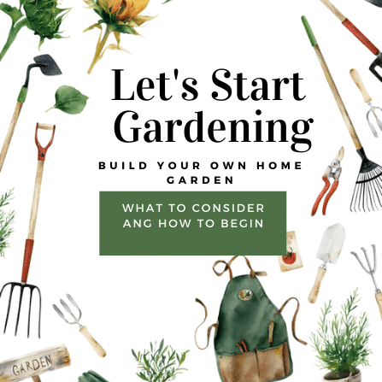
Lets Start Gardening
WHAT TO CONSIDER
AND HOW TO BEGIN
Notes:
Good evening. I am Ann

Slide 2

You don’t have to be perfect
Remember....
You don't have to be perfect
to be amazing!!

Slide 3
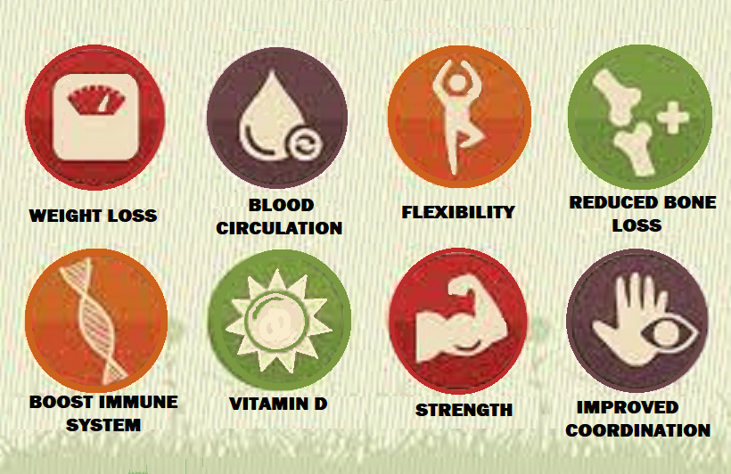
The Physical Benefits of Gardening

Slide 4

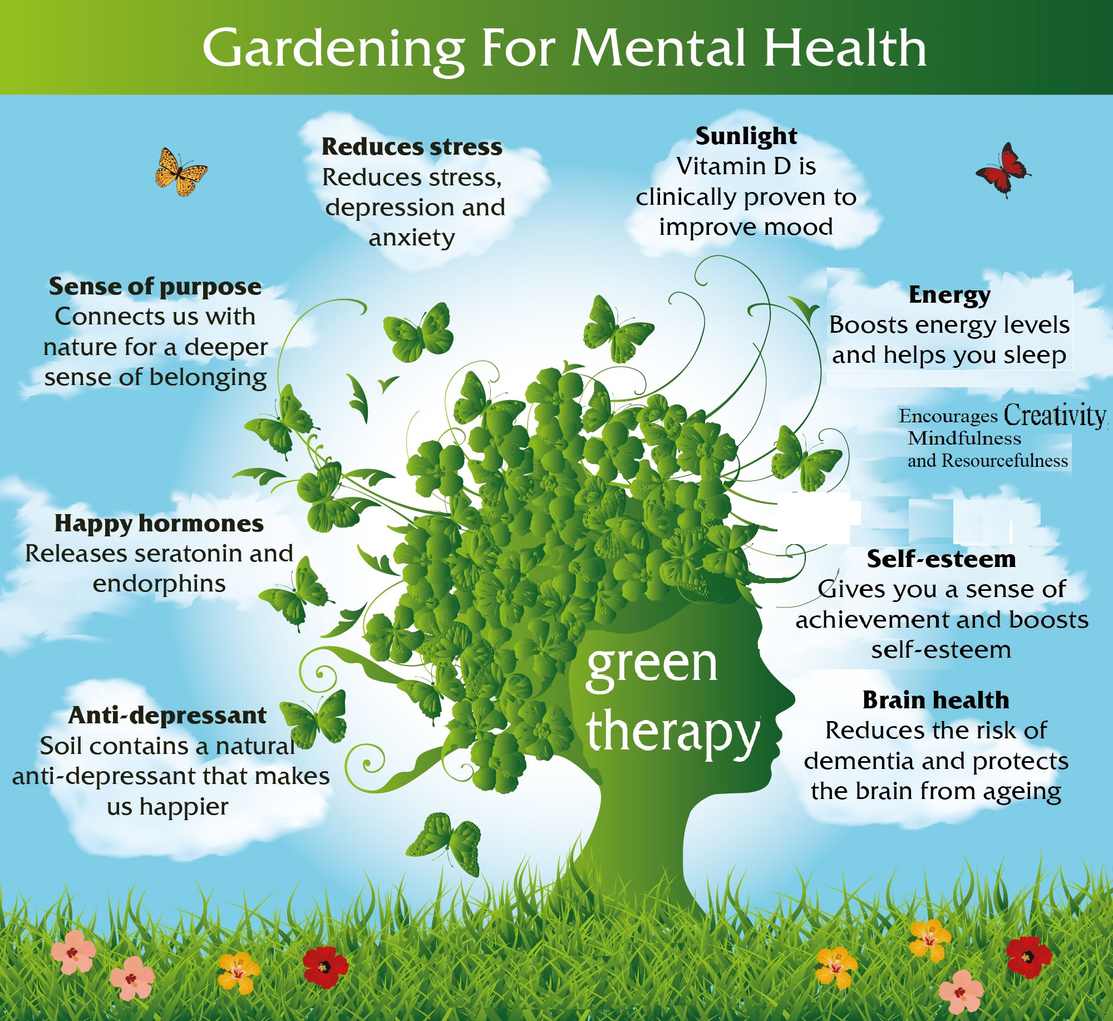

Slide 5
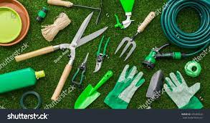
THINGS TO CONSIDER When Starting your
GARDEN

Slide 6
1. How much time you can spend
2. How much work are you able to do
3. What is your budget?

Slide 7
Consider the type of Garden that you want to create
* Vegetable * Raised bed
* Perennial * Water garden
* Annual border
* Container

Slide 8
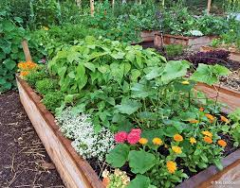
Vegetable Garden
Vegetable Garden
Grows best in full sun
Water regularly
Consistent care
Feed regularly
Control pests

Slide 9
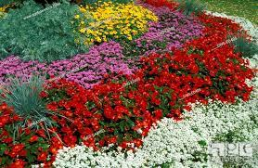
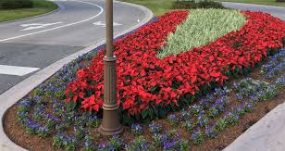
Annual Border
Annual Border
Planted every year
Constant color
Removed at end of the season
Flower choice can be
based on amt of sun
Short term: Low Cost
Long term: High Cost

Slide 10
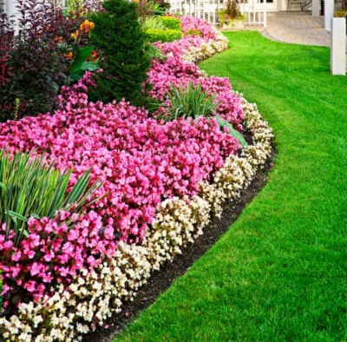

Slide 11
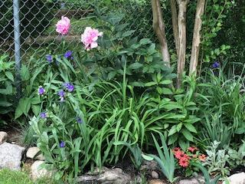
Perennial Garden
Perrenial Garden
Planted once and returns each year
Plants bloom at a specific time
Plant choice can be
based on the amt of sun
Short term: High Cost
Long term: Lower Cost

Slide 12

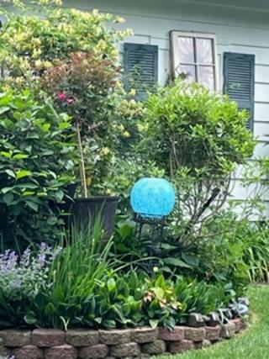
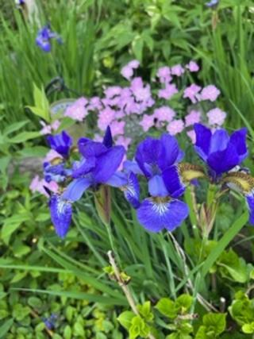
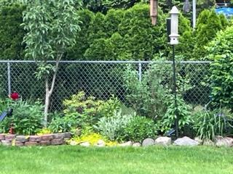
Perennial Gardens

Slide 13
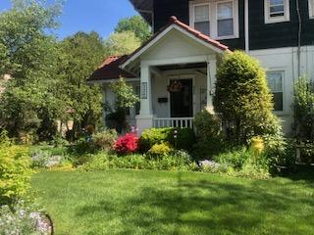

Slide 14
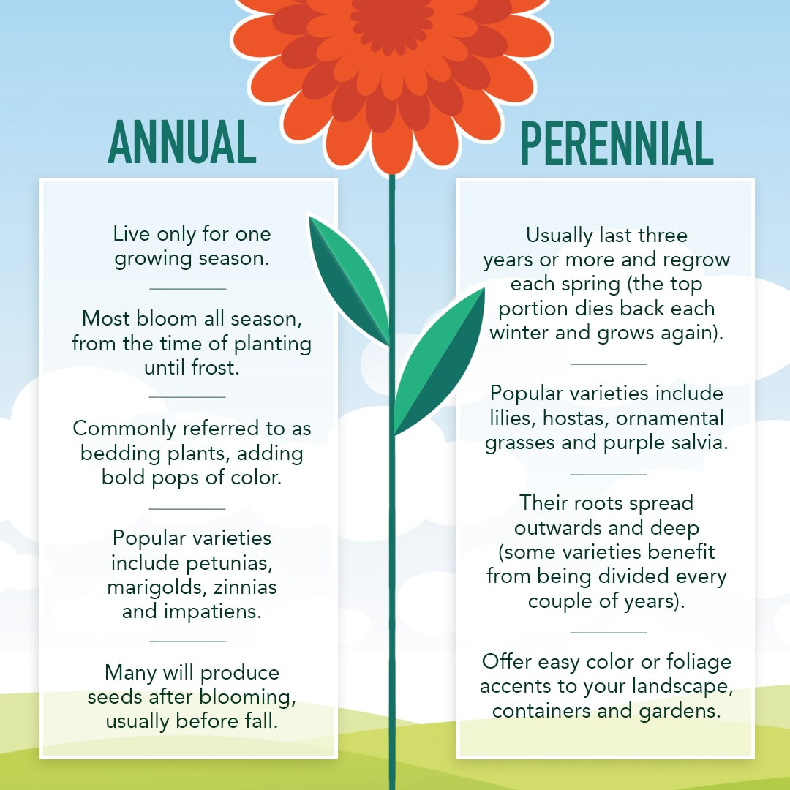
Annuals vs Perennial

Slide 15
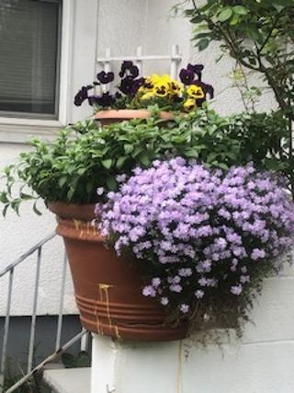
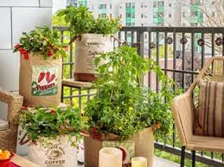
Container Garden
Container Garden
Can be moved around
Must be watered frequently
Can be annual/ perennial/ both
Limited root space

Slide 16
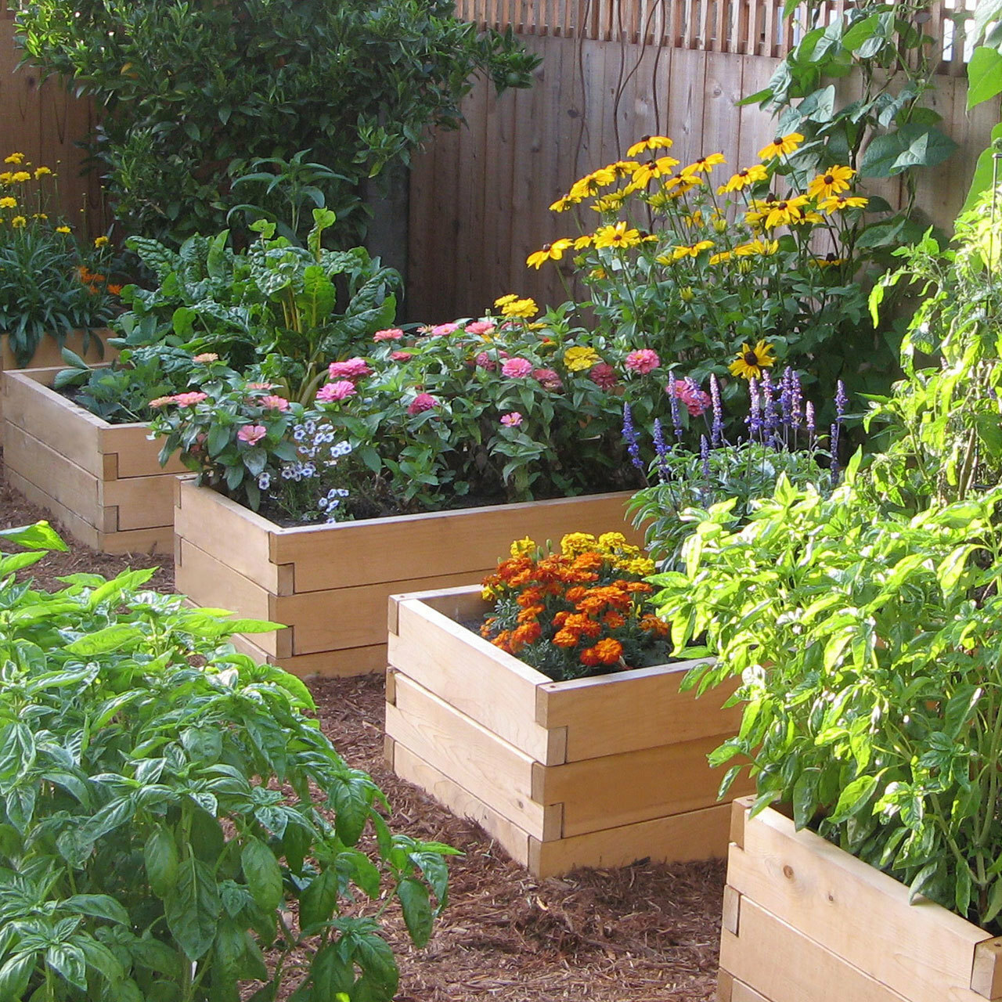
Raised Bed
Raised Bed
Can be vegetable or flowers
Easier to till and dig
Easier on your back
Less weeds
Better drainage
Ability to control organic matter and nutrients

Slide 17
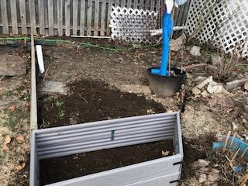
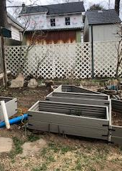
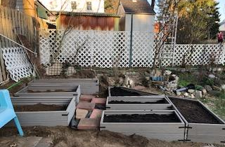

Slide 18
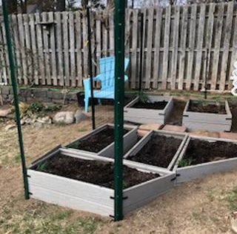

Slide 19
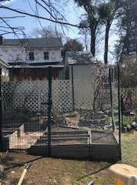
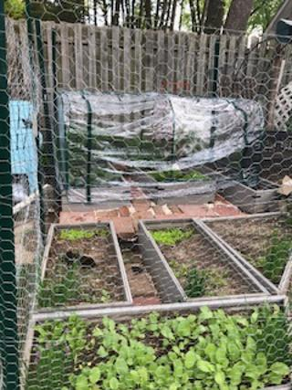

Slide 20
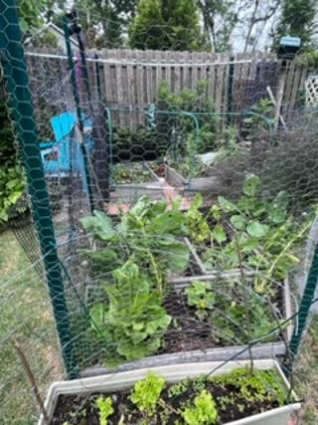

Slide 21
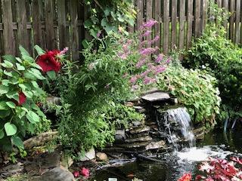

Water Garden
Water Garden

Slide 22
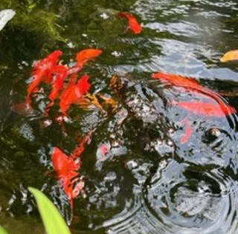

Slide 23
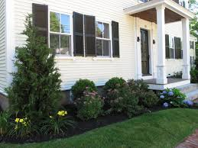
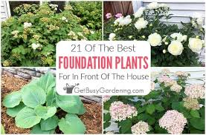

Foundation Planting
Foundation Planting
Plants hide the foundation
of your house
Blends house with front yard
Soften edges of house
Mainly evergreens

Slide 24
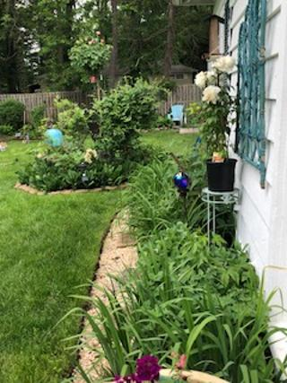

Slide 25
Consider your
Environment
Consider
Your
Environment
Consider your
Garden Environment

Slide 26
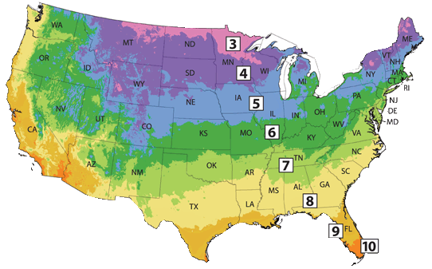
What Zone are you In? in?
USDA Plant Hardiness Zone Map
The standard by which gardeners and growers can determine
which plants are most
likely to thrive in a
location
This is based on the
coldest and hottest
temperatures, the average
winter/summer temperatures,
and average date of the first and last frost

Slide 27
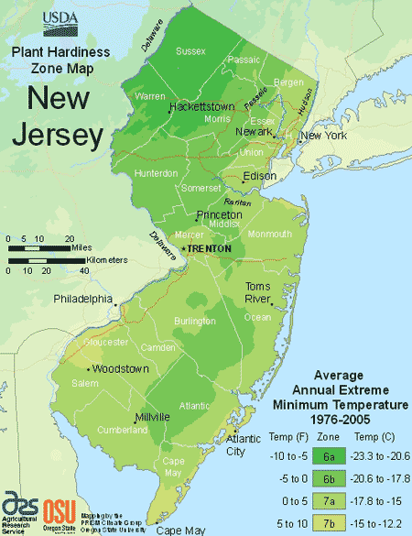
New jersey Map

Slide 28
Northeast New Jersey
Hardiness Zone
6B
Last Frost Date: May 15
First Frost Date: October 15

Slide 29
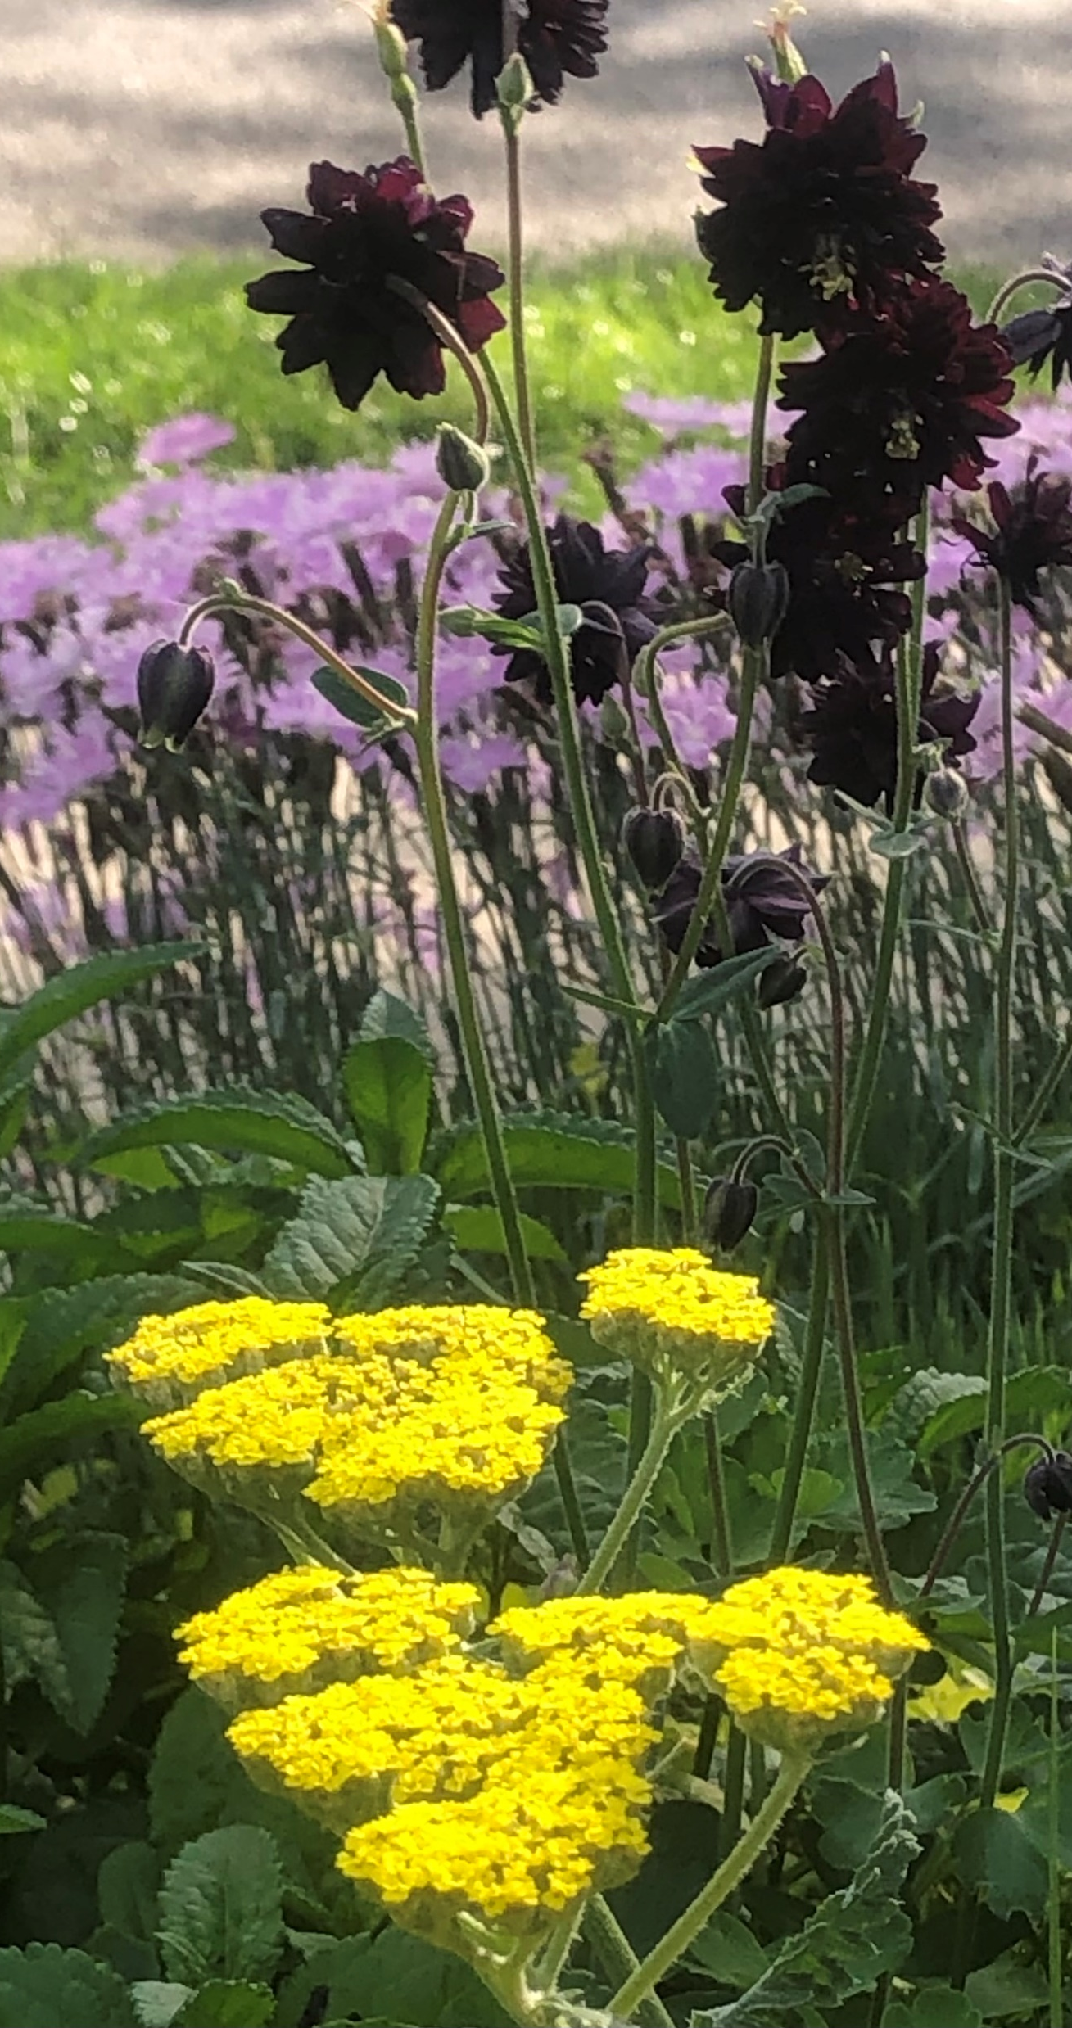
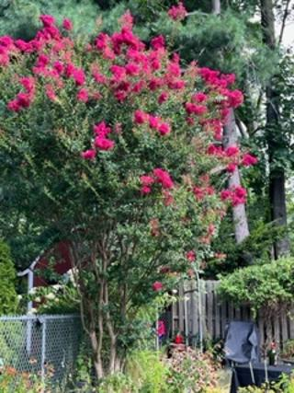
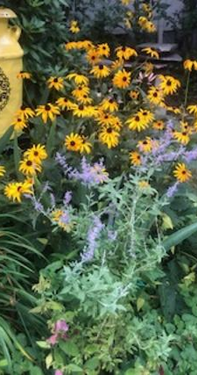

Slide 30
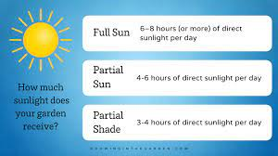









How Much Sun does your Garden Get?
How much
Sunlight does
your garden
receive?
Full Sun
6-8 hours of direct sunlight per day
Partial
Sun
4-6 hours of direct sunlight per day
Partial
Shade
3-4 hours of direct sunlight per day

Slide 31
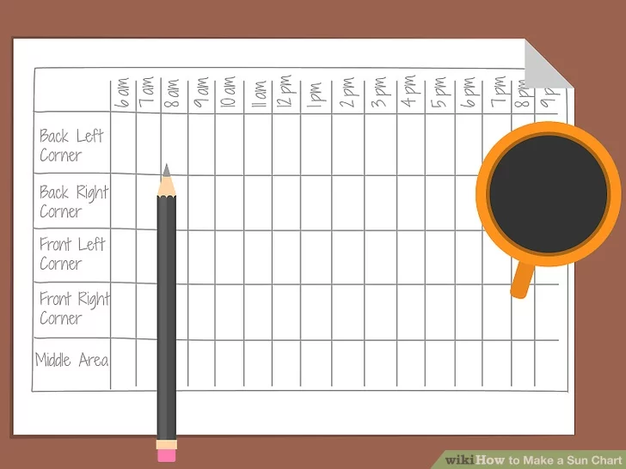
Make a sun chart
Make a sun chart

Slide 32
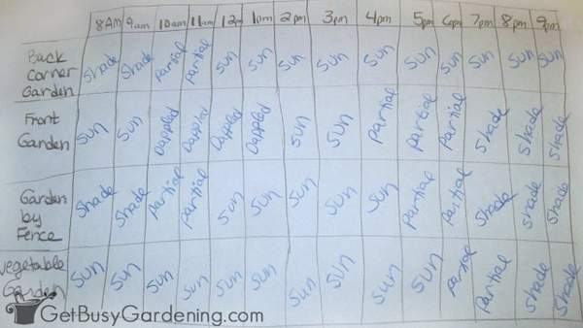
Chart sun from morning til dusk
Chart sun from morning til dusk

Slide 33
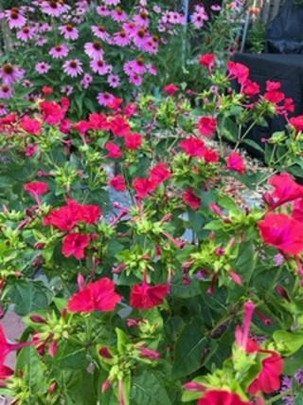
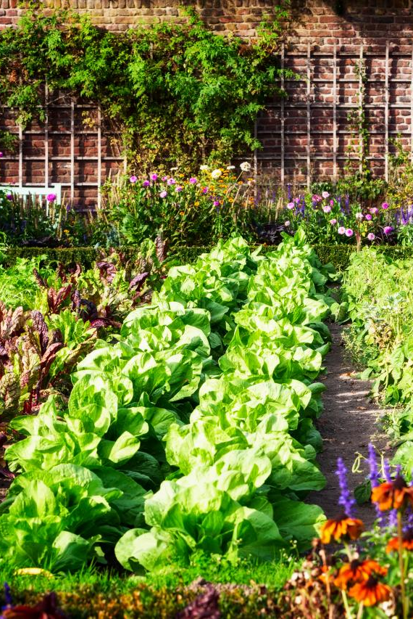
Full Sun
Best for vegetable gardens
Most variety of annuals and perennials
Full Sun Garden

Slide 34
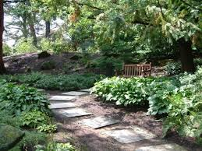
Shade garden
Shade Garden
* Use different textured
greens
* Add rocks and water
* Shade loving flowers
planted in large clumps
* Variegated leaves
* Plant shade shrubs

Slide 35
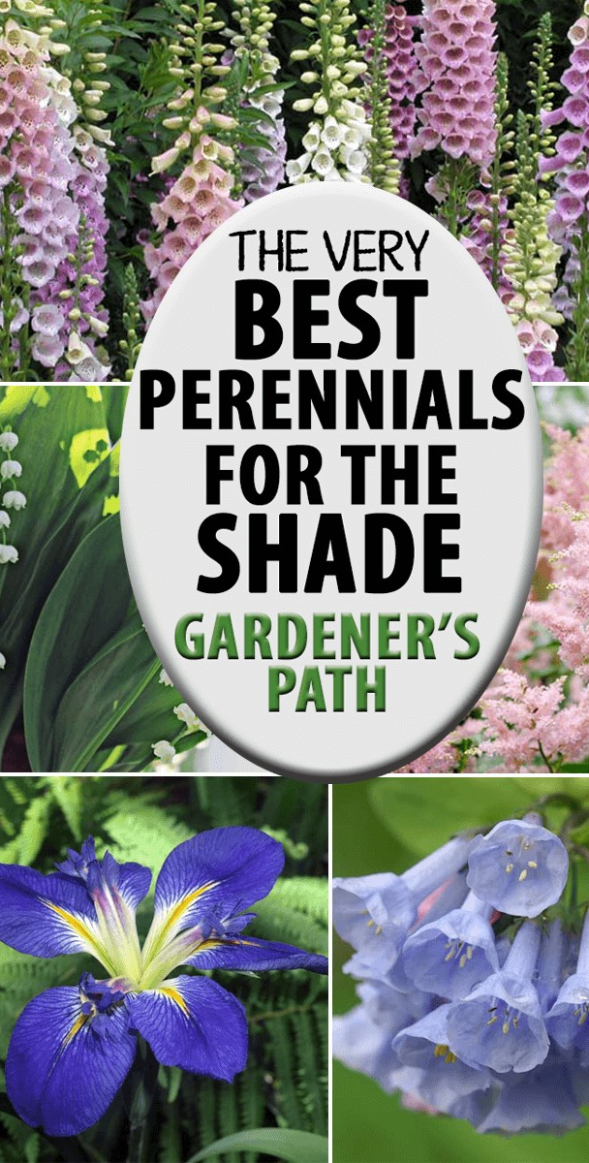
Best flowering plants for
Shade
Perennial Annual
Astilbe Impatiens
Foxglove Begonia
Lilly of the Valley Coleus
Bleeding Heart Alyssum
Virginia bluebells Pansy
Pulmonaria Lobelia
Solomon’s seal Nicotiana
Foliage Plants
Hosta (perennial)
Japanese Painted Fern (perennial)
Caladium (annual)

Slide 36
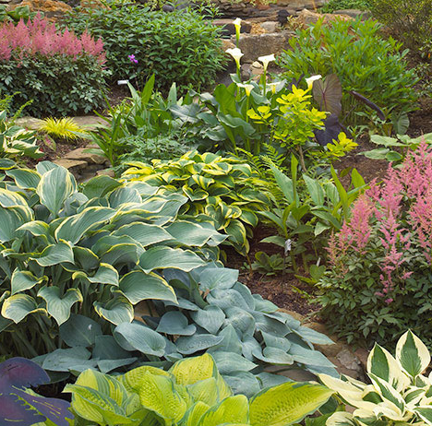

Slide 37
Temperature Preferences
Temperature Preferences
Cool season plants: These plants perform best in the cool weather of spring and fall (or winter in mild regions).
Vegetables: broccoli, cabbage, lettuce, peas, radishes, spinach
Flowers: calendula, pansies, primroses, snapdragons
Heat-loving plants: These plants thrive in the heat of midsummer.
Vegetables: beans, corn, cucumbers, peppers, squash, tomatoes
Flowers: marigolds, sunflowers, zinnias

Slide 38
Consider the elements you want to include in your garden
Consider
the
Elements
to
include
in your
Garden

Slide 39
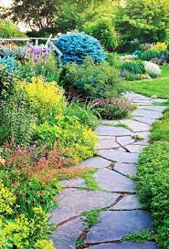
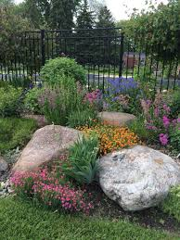
hardscape
Elements:
Hardscape

Slide 40
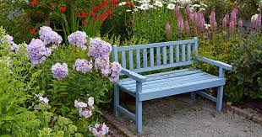
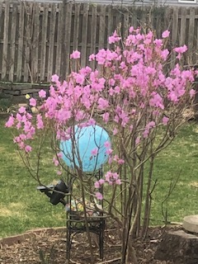
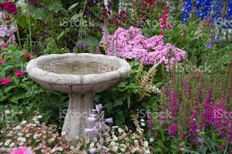
decor
Elements:
Furniture and decor

Slide 41
Anchoring Plant
Elements:
Anchor plants
An anchor plant is a taller plant, usually a woody shrub
or small to dwarf-sized tree, around which you
plant your garden. These plants work as focal points
within your garden or landscaping; your design will have
a sense of structure and form to it.

Slide 42
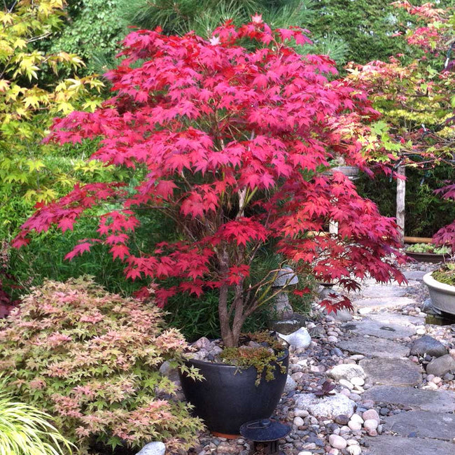

Slide 43
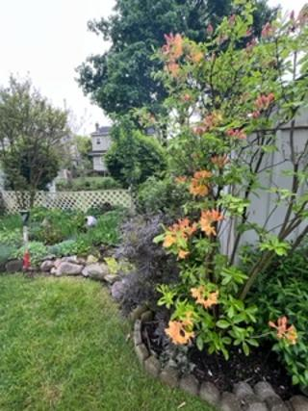
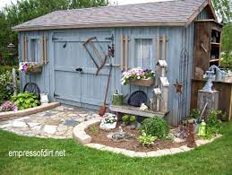
structures

Slide 44
Consider the size and shape
Consider the size and shape
that you want to create
Decide on where you will site your garden
Use a hose or rope to outline the garden shape

Slide 45


Start small
Start small !

Slide 46


Slide 47



Slide 48
Breaking Ground
Breaking Ground
Use a shovel to outline the design that you created
Water the area before you begin
Remove the sod with your shovel
Place sod in a wheelbarrow for use in other places
Call before you dig
Turn soil to at least 12 inches
Amend the soil

Slide 49


Slide 50


Slide 51


Slide 52

Call
Before
You
Dig !

Slide 53

Garden soil amendments: 6 organic choices to improve your soil
Why add garden soil amendments?
We often hear that soil is made up of particles like sand, silt, and clay, but that’s only part of the story. Soil is a complex ecosystem containing minerals, organic materials, microbes, and countless organisms which vary from region to region, and often from yard to yard. Soil anchors plants, but it also provides water and nutrients. New gardeners quickly learn the importance of building soil, and experienced gardeners prize the dark crumbly compost that comes out of their backyard bins.
Gardeners add soil amendments to their vegetable plots and flower gardens to grow better plants. But what do these materials really do for our soil? Here are a few of the many benefits of applying amendments:
To increase soil organic matter
To support the soil food web (read more about that HERE)
To increase the moisture holding capacity of soil
To improve the texture and structure of soil
To improve soil aeration
To promote healthy plant growth and reduce plant diseases

Slide 54

Amend soil

Slide 55
Why add garden soil amendments?
*Soil is a complex ecosystem containing minerals,
organic materials, microbes, and organisms
which vary from yard to yard.
*Soil anchors plants, provides water and nutrients.
Benefits of applying amendments:
To increase soil organic matter
To increase the moisture holding capacity of soil
To improve the texture and structure of soil
To improve soil aeration
To promote healthy plant growth and reduce plant diseases

Slide 56
Easy Soil Amendments
Compost
Chopped leaves or leaf mold
Peat Moss
Garden soil
Composted Manure
(in small amounts)

Slide 57


PLANTING . . .
Here comes the fun part!
Vegetables Perennials
Plant cold season vegetables first Can be planted spring to fall
Warm season after May 15 Dig hole twice as wide and
Plant in rows as deep as container
Proper spacing Tease out roots
Consider Height of plants Tall perennials to the back
Consider sun movement Leave room for growth
Water deeply
Annuals Containers
Plant offset rows Use hill, thrill, fill and spill
Follow the line of the bed Consider color and texture
Leave room for growth
Use low growing plants at edge

Slide 58



Slide 59

Common Name. This is what the
plant is generally called.
Scientific Name. Every plant has
a scientific name.
Mature Height and Spread. This is the maximum height and width the plant is likely to reach when fully grown.
Hardiness Zone These numbers let you know the region a plant grows best in.
Sun Exposure

Slide 60
Six Tips For Watering Your Garden
Focus on the root zone.
roots need access to water, not the leaves
Water only when needed.
reduce frequency when rainfall is abundant
Too much moisture can be damaging
Water deeply and thoroughly
Lawns and annuals concentrate their roots in the top 6" of soil
Perennials, shrubs and trees, it's the top 12
Water in the morning
Leaves have time to dry out
Mulch everything
Mulch reduces surface runoff and slows evaporation from the soil
Use the right tool
use a soaker hose or watering can for precise watering to the root zone

Slide 61
If in doubt….
On Watering……
Word to the wise…
Don’t !

Slide 62



Slide 63



Slide 64


Slide 65


Slide 66




Slide 67


Slide 68


Slide 69

Thank you for your
interest and attention
Consider joining the
Westwood Library
Garden Club
Follow us on
Facebook
Add your Name to
our Email List

Slide 70


Slide 71

Next In Our Series:
February: Bee Keeping
March: Beginner Bonsai
April: Gardening the Green Way

